Slide 1

User interface goal
Muscular effort
Breaking the Barrier
Notes:
The ultimate goal of an interface is to transmit the user’s goal to the object as quickly, efficiently, and accurately as possible.
Muscular effort is still needed (Keyboards, mice, etc.)
BCI bridges that muscular gap.

Slide 2
BCI
What is BCI?
History
How BCI Works
Recent Research Projects
Current Uses
Problems
Discussion on future uses

Slide 3
What is BCI?
BCI uses electrophysiological signals to accomplish a user goal
These signals originate in the brain and are used by machines to perform tasks

Slide 4
History
1929, first alpha rhythm detected
1967, subjects transmit Morse code
1970’s, United States DOD wants fighter pilots to control flight with the mind
1973, Jacques Vidal publishes paper laying the groundwork for BCI despite inadequateness of current technologies
Notes:
1929-Hans Berger doubted the 8-12Hz signals he observed
1967-Edmond Dewan uses an EEG. Subjects, with practice are able to reduce amplitude of brain's ‘alpha’ rhythms
1970’s-DOD Success limited by current technologies, project concelled.

Slide 5
How BCI Works
Electrodes are strategically placed near the user’s brain
Signals from the brain are received and amplified (approx. 10,000 times)
These amplified signals are filtered
Filtered signals are allocated to specific pre-programmed tasks the machine can complete

Slide 6
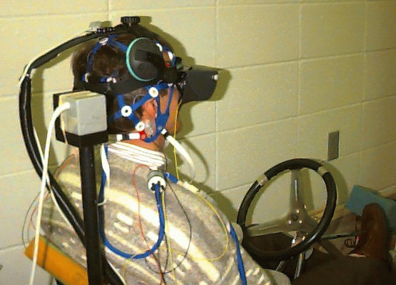
Electrode Placement

Slide 7
Signal Types
Mu and alpha Rhythms
Event Related
Slow Cortical Potential
P3 Component of the Evoked Potential
Short-Latency Visually Evoked Potentials
Individual Neurons
Notes:
ALL come from EEG
-sensorimotor cortex related
-relates to movement, may be trained, relates to imagined movement
-large shifts in EEG activity
-positive shift after task relative stimulus
-produced by short visual stimulus
-direct contact with neurons required, growth around sensors encouraged, invasive
--tell about the neighbors behind the wall analogy

Slide 8
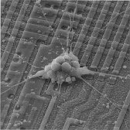
Bionic Neuron

Slide 9
Signal Filtering
Choosing signal most suited to the specific task
Difficulty in filtering that signal from the billions of others concurrently happening
Filtering for mass neuron signals
Algorithms are necessary for converting filtered signals from analog to digital
Notes:
-tell about the billion people in one room analogy

Slide 10
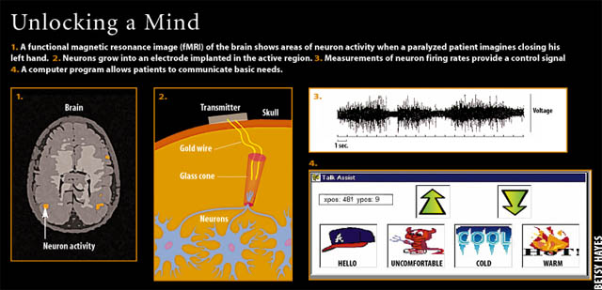
Direct Neural Contact

Slide 11
Current Uses
Most prominent use: aiding victims of locked-in syndrome
“I got tears in my eyes, turned to my sister, and said, ‘Damn, I actually moved my hand by thinking about it.’”
--Controlling Prosthetics

Slide 12
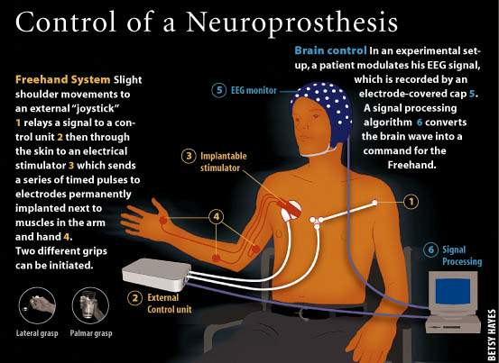
Neuroprosthesis

Slide 13

The Brain Bar
The bar that serves you the drink you deserve

Slide 14
Problems with BCI
BCI needs inter-disciplinary recognition
Standards needed:
  Signal use
  Filtering
  Algorithmic conversion
  BCI performance measurement

Slide 15
Problems with BCI
Application Selection
Ease of Use

Slide 16
The Future of BCI
???

